Slide 1
Smart traffic urban optimization using raspberry pi and computer vision
Capstone Project Phase 2
6 Credits
Project ID :S30
ESA Evaluation
Department of Electronics and Communication Engineering
Notes:
1

Slide 2
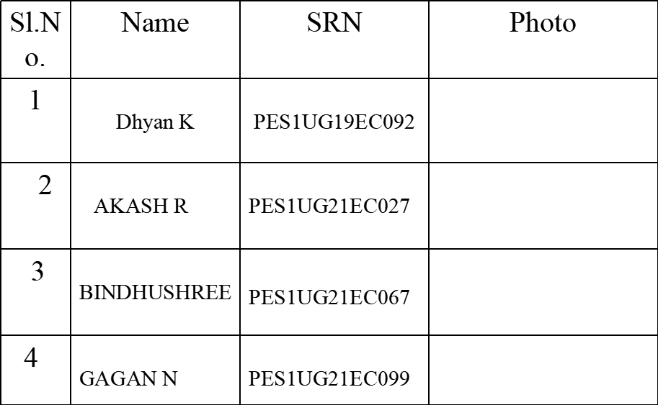

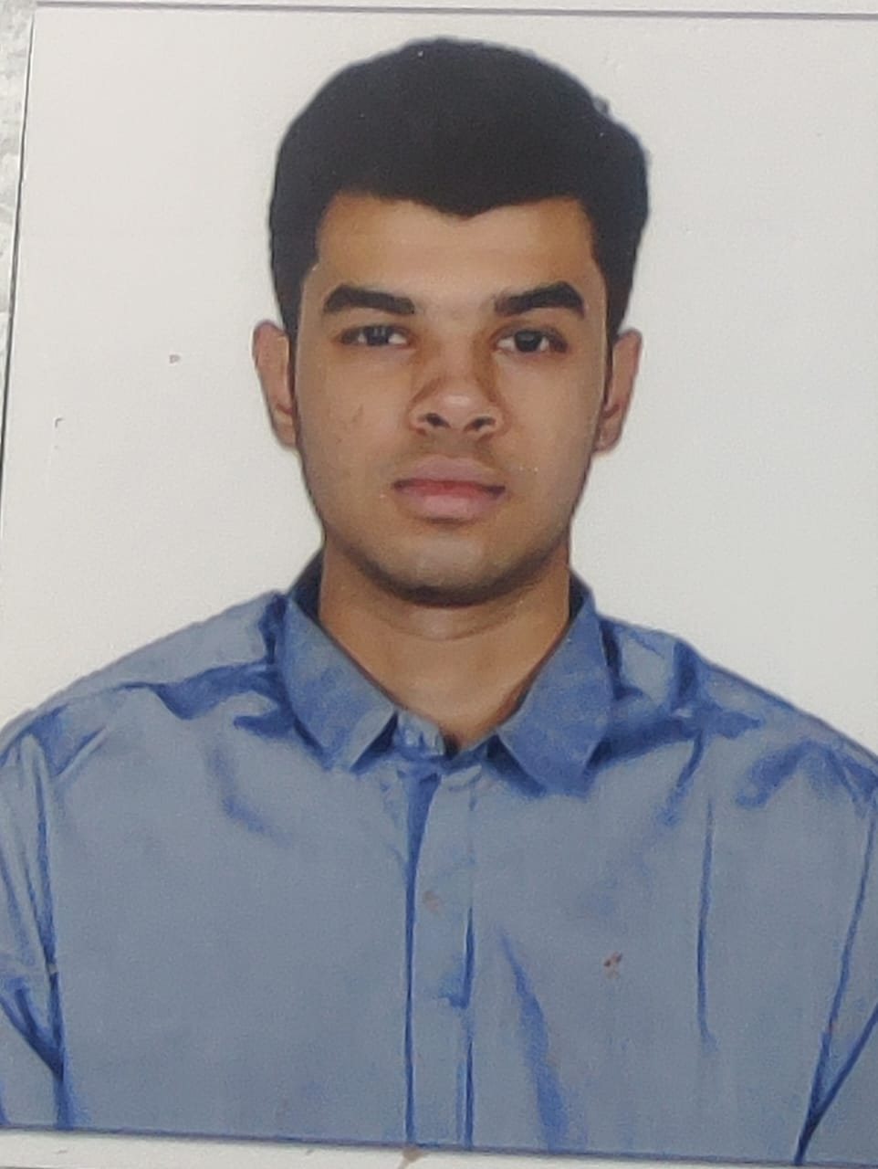
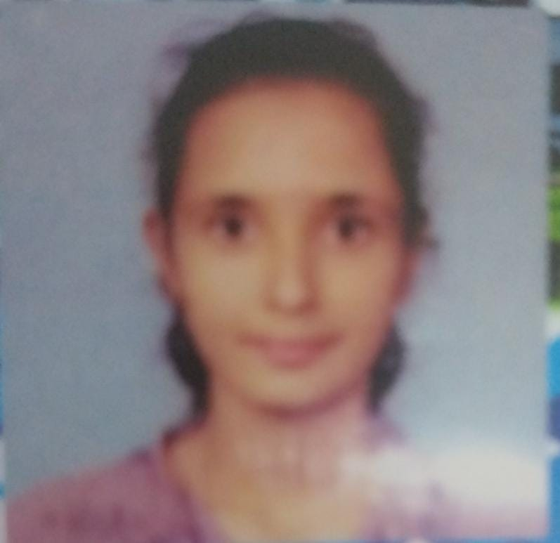
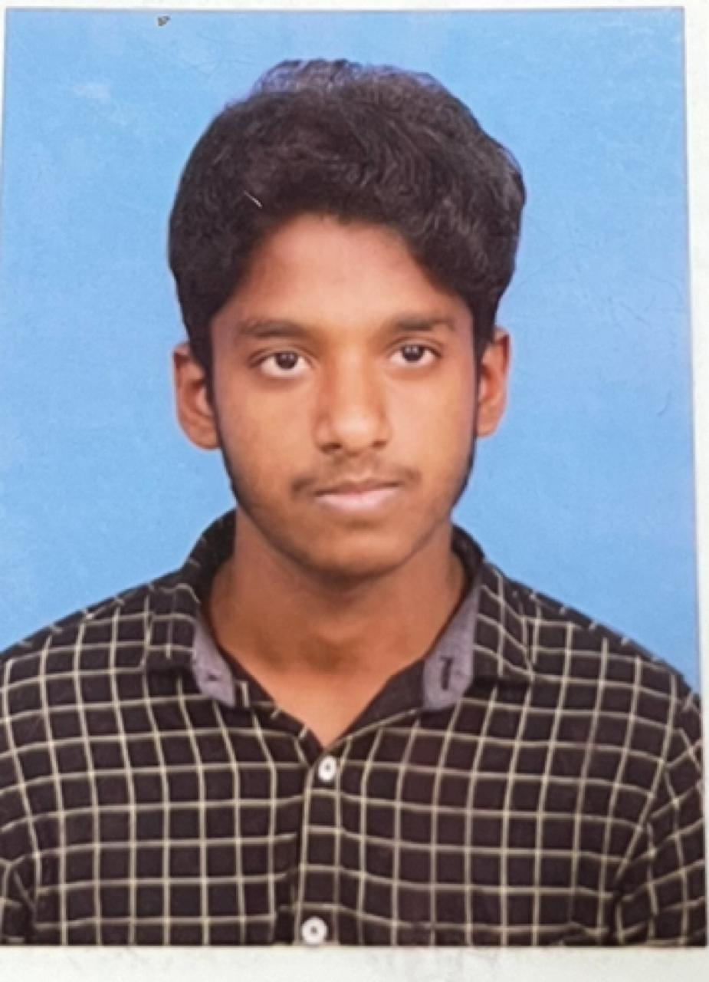
Team Composition
Guide : Prof/Dr. Babitha S Ullal (ECE)
4/12/24
Capstone Project B.Tech 2021-25 Phase -2 ESA
2

Slide 3
Contents
Introduction & Motivation
Summary of Literature
Gaps in literature
Objectives
Problem Statement
Proposed Methodology
Implementation details
Results and Analysis
Conclusion & Future Directions
Project timeline Gantt Chart
References
Project Deliverables (Submissions)
4/12/24
Capstone Project B.Tech 2021-25 Phase -2 ESA
3

Slide 4
Introduction & Motivation
Urban traffic congestion is a common issue in many cities, increased travel times, fuel consumption, and environmental impact. Smart traffic optimization aims to address these challenges by employing technology for real-time monitoring and control.
The Raspberry Pi serves as the core hardware platform for this project. Its compact size, low power consumption and GPIO (General Purpose Input/Output) pins make it suitable for interfacing with cameras, sensors, and actuators.
4/12/24
Capstone Project B.Tech 2021-25 Phase -2 ESA
4

Slide 5
Image Processing: Enhances images through algorithmic manipulation for tasks like noise reduction and feature extraction.
Computer Vision: Empowers machines in interpreting visuals, recognizing objects, and making decisions, spanning applications from medical diagnostics to autonomous systems.
.Our project targets this issue, aiming to create a Smart Traffic Management System for effective congestion mitigation.
4/12/24
Capstone Project B.Tech 2021-25 Phase -2 ESA

Slide 6
Summary of Literature
J. Hosur, R. Rashmi and M. Dakshayini , "Smart Traffic light control in the junction using Raspberry PI," 2019 3rd International Conference on Computing Methodologies and Communication (ICCMC).
Methodology:-Ultrasonic sensors detect vehicles approaching the junction.
Raspberry Pi measures the distance of detected vehicles using the data from sensors.
Based on the measured distance and predefined threshold, the Raspberry Pi determines whether to switch on the traffic lights, If a vehicle is within the threshold distance, the traffic lights are switched on to manage the flow of vehicles.
The GPIO library for Python 3 enables communication with the Raspberry Pi's GPIO pins, allowing for control of the traffic lights, By setting the pin numbering mode to 'BCM', GPIO pins are referenced by their Broadcom SOC channel numbers.
Ultrasonic sensor connections (VCC to 5V power, TRIG and ECHO to BCM pins 4 and 17, ground to pin 39)
LED connections (short leg to pin 6 for ground, long leg to pin 27) enable the Raspberry Pi to control traffic lights based on sensor readings.
4/12/24
Capstone Project B.Tech 2021-25 Phase -2 ESA
6

Slide 7
Limitations:-
The code uses a fixed threshold distance to determine when to switch on the green light.
The logic assumes the presence of only one vehicle on one road. In reality, traffic light control systems need to handle multiple vehicles on multiple roads simultaneously.
The code is not scalable to handle complex intersections or large-scale traffic networks.
Advantages:
The system reduces power consumption during non-peak hours by only activating the traffic light when vehicles are detected, thus conserving energy.
Utilizes affordable components such as Raspberry Pi and ultrasonic sensors, offering a cost-effective solution for traffic management compared to traditional systems
It's easy to set up and operate, even for those without advanced technical knowledge
Smooth traffic flow
Conclusion:-
This paper presents a Smart Traffic Light Control System using Raspberry Pi and IoT
technology By integrating sensors with Raspberry Pi, it optimizes traffic flow, GPIO
library for Python 3 enables communication with the Raspberry Pi's GPIO pins
4/12/24
Capstone Project B.Tech 2021-25 Phase -2 ESA

Slide 8
H. Susilawati, S. L. Pathur Rahman, A. Rukmana, I. M. Malik Matin, Sarbini and N. Ismail, "Smart Traffic Light Using Raspberry Pi and Digital Image Processing" 2023 9th International Conference on Wireless and Telematics (ICWT), Solo, Indonesia, 2023, pp. 1-6, doi: 10.1109/ICWT58823.2023.10335398.
Methodology: The study demonstrates that Raspberry Pi 4, combined with digital image processing, can be used for dynamic traffic light management.The system effectively adjusts green light durations based on the number of vehicles, though delays in processing and data transmission need to be addressed for improved performance.
Advantages:
Integration of OpenCV and TensorFlow: Utilizing these powerful libraries allows for effective image processing and object detection, enabling accurate vehicle counting and real-time updates to traffic light durations.
Web Server Integration: Data on vehicle counts and traffic light timings are uploaded to a web server, which can be useful for monitoring and managing the system remotely.
4/12/24
Capstone Project B.Tech 2021-25 Phase -2 ESA

Slide 9
Disadvantages:
Detection Delay: The system experiences a significant delay in object detection and data transmission, particularly when using Raspberry Pi 4. This delay can affect the real-time accuracy of the traffic light adjustments.
Image Processing Challenges: The effectiveness of the image processing methods (Haar Cascade and SSD) is limited by factors such as lighting conditions and the speed of vehicle movement, which can impact accuracy.
Hardware Limitations: Raspberry Pi, while versatile, may not handle high-resolution image processing as efficiently as more powerful computing systems, leading to potential performance bottlenecks.
Conclusion:
The paper demonstrates that a smart traffic light system using Raspberry Pi and digital image processing can effectively manage traffic light durations based on real-time vehicle counts, potentially improving traffic flow and reducing congestion.
4/12/24
Capstone Project B.Tech 2021-25 Phase -2 ESA

Slide 10
A. Gupta, C. Gandhi, V. Katara and S. Brar, "Real-time video monitoring of vehicular traffic and adaptive signal change using Raspberry Pi" 2020 IEEE Students Conference on Engineering & Systems (SCES), Prayagraj, India, 2020, pp. 1-5, doi: 10.1109/SCES50439.2020.9236731.
Methodology: The proposed methodology combines image processing techniques with Raspberry Pi hardware to monitor traffic density and adjust signal timings accordingly using live video capturing
Advantages: This method effectively reduces the traffic and waiting time at the signal
Disadvantages: The application is restricted only to a single lane
Conclusion : This proposed framework lessens the chance of congested driving conditions and cleared the traffic as per the vehicular density.
4/12/24
Capstone Project B.Tech 2021-25 Phase -2 ESA

Slide 11
Objectives
Improved Traffic Flow: Dynamic adjustment of traffic signal timings based on real-time data can lead to smoother traffic flow, reducing congestion and travel times for commuters.
Enhanced Safety: Prioritizing emergency vehicles and optimizing traffic flow can improve safety by reducing the risk of accidents and expediting emergency response times.
Using efficient image classification techniques such as optical flow and background subtraction, image detection process ,preprocessing techniques to enhance algorithm performance for easy traffic flow.
4/12/24
Capstone Project B.Tech 2021-25 Phase -2 ESA
11

Slide 12
Problem Statement
To reduce commute times by providing easy traffic flow using raspberry pi.
4/12/24
Capstone Project B.Tech 2021-25 Phase -2 ESA
12

Slide 13
Proposed Methodology
Raspberry pi:
Recorded video
Grayscale Conversion
Edge Detection
Shape Identification
Communication with Server
Feature Extraction
ML Model
Output
4/12/24
Capstone Project B.Tech 2021-25 Phase -2 ESA
13

Slide 14
ML MODEL:
Data
Feature Extraction
Training and Testing
Implementation
Capstone Project B.Tech 2021-25 Phase -2 ESA
4/12/24

Slide 15
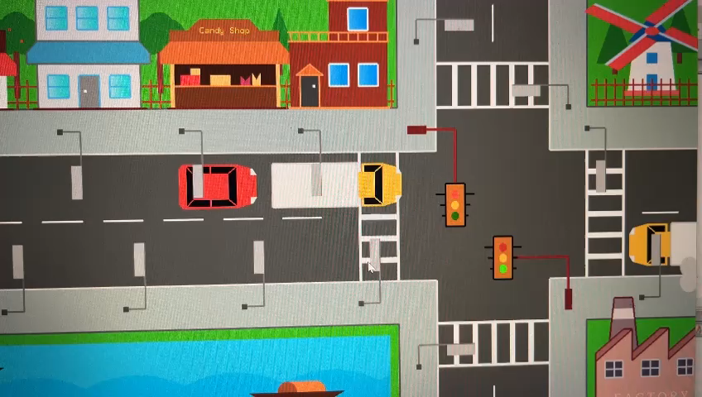
Implementation Details
Simulation:
4/12/24
Capstone Project B.Tech 2021-25 Phase -2 ESA
15

Slide 16
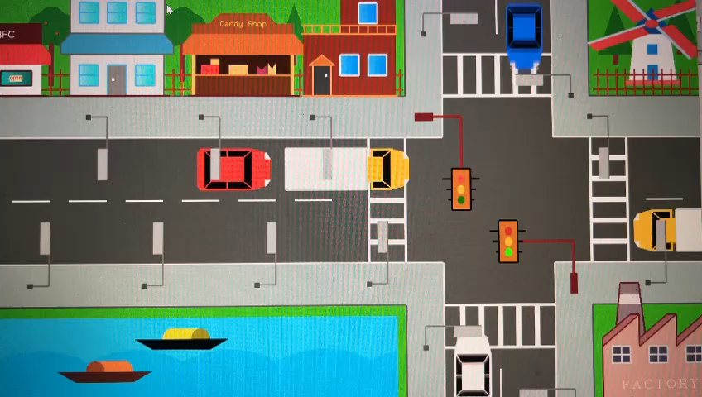
Priority For the Ambulance:
4/12/24
Capstone Project B.Tech 2021-25 Phase -2 ESA

Slide 17
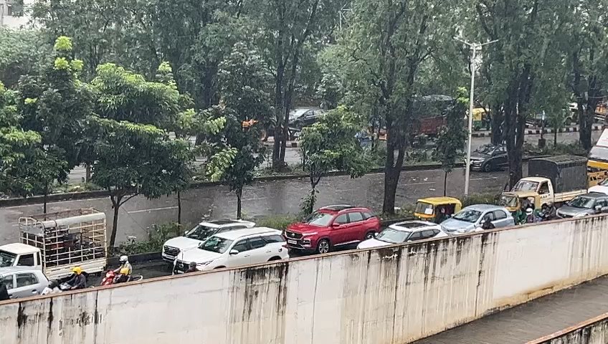
Results and Analysis
Input of recorded video:
4/12/24
Capstone Project B.Tech 2021-25 Phase -2 ESA
17

Slide 18
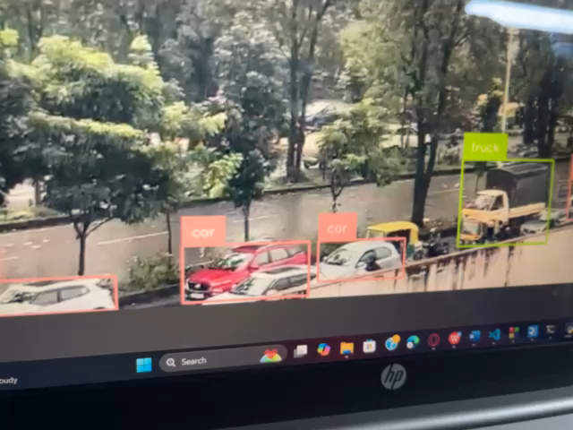
Testing of the camera after the input of recorded video using all the methods displayed in Real Vnc:
4/12/24
Capstone Project B.Tech 2021-25 Phase -2 ESA

Slide 19
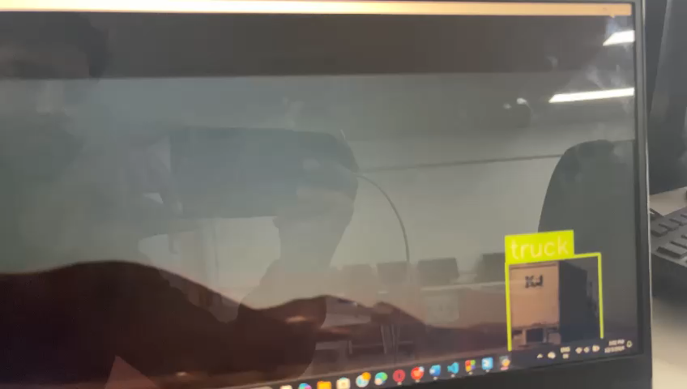
2)
Recorded video 2:
4/12/24
Capstone Project B.Tech 2021-25 Phase -2 ESA

Slide 20
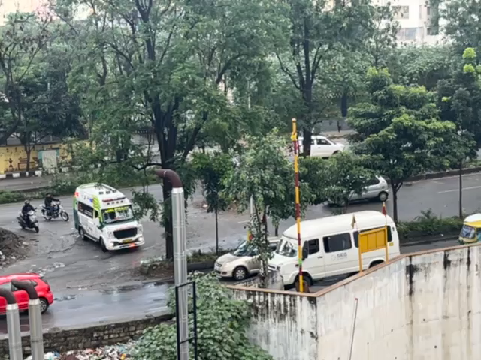
3)Recorded video 3:
4/12/24
Capstone Project B.Tech 2021-25 Phase -2 ESA

Slide 21
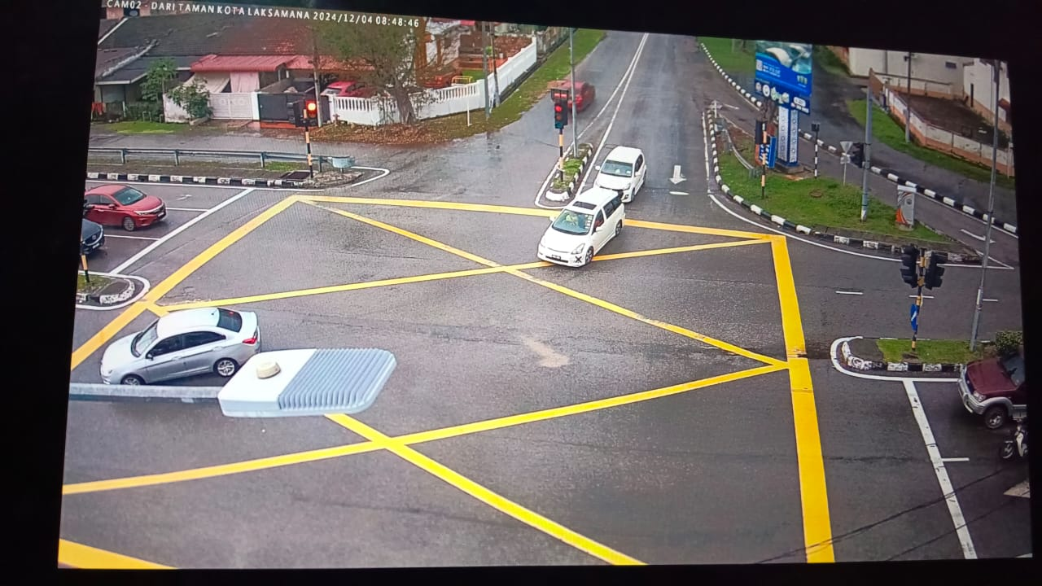
4)Implementation of camera for lane using raspberry pi as server:
4/12/24
Capstone Project B.Tech 2021-25 Phase -2 ESA

Slide 22
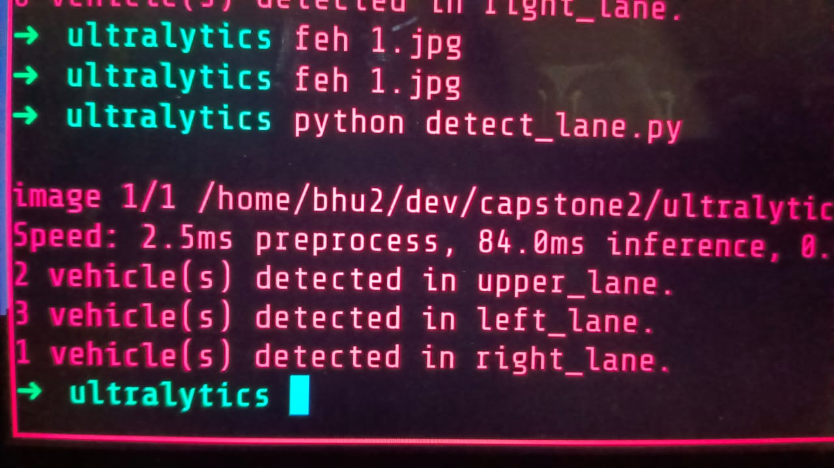
4/12/24
Capstone Project B.Tech 2021-25 Phase -2 ESA

Slide 23
Conclusion
The traffic density-based lane management system utilizing Raspberry Pi and image processing techniques provides a cost-effective and efficient solution for addressing urban traffic congestion.
By detecting vehicles in real-time, analyzing lane-wise vehicle density, and dynamically prioritizing traffic flow, the system significantly optimizes traffic management at intersections.
The integration of a compact and energy-efficient Raspberry Pi with advanced algorithms like YOLO ensures accurate vehicle detection and seamless decision-making.
This smart traffic control system minimizes delays.
4/12/24
Capstone Project B.Tech 2021-25 Phase -2 ESA
23

Slide 24
Future Directions
Fine tuning the yolo model
Prioritizing the emergency vehicles
4/12/24
Capstone Project B.Tech 2021-25 Phase -2 ESA

Slide 25
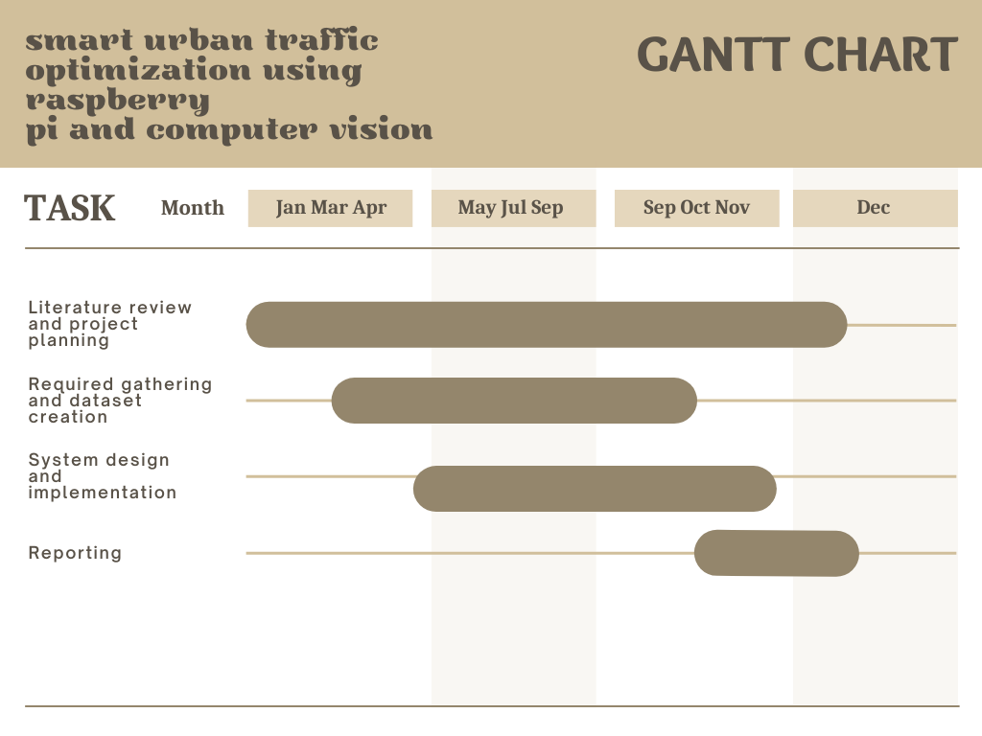
Project Timeline
4/12/24
Capstone Project B.Tech 2021-25 Phase -2 ESA
25

Slide 26
References
[1] H. Susilawati, S. L. Pathur Rahman, A. Rukmana, I. M. Malik Matin, Sarbini and N. Ismail, "Smart Traffic Light Using Raspberry Pi and Digital Image Processing," 2023 9th International Conference on Wireless and Telematics (ICWT), Solo, Indonesia, 2023, pp. 1-6, doi: 10.1109/ICWT58823.2023.10335398.
[2] A. Gupta, C. Gandhi, V. Katara and S. Brar, "Real-time video monitoring of vehicular traffic and adaptive signal change using Raspberry Pi," 2020 IEEE Students Conference on Engineering & Systems (SCES), Prayagraj, India, 2020, pp. 1-5, doi: 10.1109/SCES50439.2020.9236731.
[3]J. Hosur, R. Rashmi and M. Dakshayini , "Smart Traffic light control in the junction using Raspberry PI," 2019 3rd International Conference on Computing Methodologies and Communication (ICCMC).
4/12/24
Capstone Project B.Tech 2021-25 Phase -2 ESA
26

Slide 27
Individual Contributions
Contributions
Sl. No. | NAME | CONTRIBUTIONS
1 | Akash R | Implementation and obtaining result
2 | Bindhushree | Implementation and obtaining result
3 | Dhyan K | Code and ppt preparation
4 | Gagan N | Implementation and obtaining result
4/12/24
Capstone Project B.Tech 2021-25 Phase -2 ESA

Slide 28
Deliverables Submissions
S30
Sl. No. | Submission | Details
1 | Project Report | As per format with Plagiarism report and Poster
2 | Project Poster | A4 size color hard copy and soft copy
3 | Project Diary | Submitted to the Panel
4 | Individual Contribution Form | Submitted and signed by each student
4/12/24
Capstone Project B.Tech 2021-25 Phase -2 ESA
28

Slide 29
Q & A
Notes:
29

Slide 30
Thank You
Notes:
30

